Slide 1





The Windmill Primary Federation
Terrington St John Primary Tilney St Lawrence Primary
Walpole Highway Primary West Walton Primary
SEND Information Report (Updated September 2025)
All governing bodies of schools and nurseries have a legal duty to publish information on their website concerning the implementation of their policy for students with SEND.
This information will be updated at least annually.

Slide 2

Admissions & School Places
Schools Approach & Rationale
Who’s Who in Our Team?
Staff Training
Responsibilities: SENDCo
Responsibilites: Teaching Staff
Responsibilities: Student & Home
Definition of SEND
Types of SEND
Working Together
Identification of SEND (1)
Identification of SEND (2)
Assess-Plan-Do-Review Cycle
Application for an Educational, Health & Care Plan (EHCP)
The LA and their support services
What Provisions are available here for a Child with SEND?
Adaptations to the Curriculum & Learning Environment for Pupils with SEND
Our School’s Approach to Teaching SEND
Engagement & Learning Support
Arrangements for Assessing & Reviewing the Progress of Pupils with SEND (1)
Arrangements for Assessing & Reviewing the Progress of Pupils with SEND (2)
Funding
Additional Funding
Additional Support for Learning
Evaluation of the Effectiveness of Provision
How we enable pupils with SEND to engage in school activities together with pupils without SEND
Support for the Social, Emotional & Mental Health Development of Pupils with SEND
Consultation with Parents and Young People about SEND & involving in their Education
Transition Support between Previous Setting & This School
Complaints & the Governing Body
Signposting of Policies & Procedures
Further Sources of Support

Slide 3
Welcome!
Admissions & School Places
Pupils of all abilities, needs and disabilities are admitted to our school with a warm welcome.
Admission arrangements for pupils with an Educational Health Care Plan, or who are Looked After by the local authority, are governed by the Local Authority Admissions Policy
For more information about admissions go to
https://www.norfolk.gov.uk/education-and-learning/schools/school-admissions

Slide 4
Schools Approach & Rationale
The Windmill Primary Federation of schools is committed to providing a full and efficient education to all students and embraces the concept of equal opportunities for all.
We endeavour to:
Be welcoming, safe, happy environments where everyone is respected and listened to
Provide Quality First Teaching
Nurture, within a caring environment
Be able to provide Teaching Assistants to support and encourage independence
Be supportive for the whole family
Provide a stimulating learning environment
Be committed to teamwork
Be providers of varied experiences including a wide range of opportunities

Slide 5
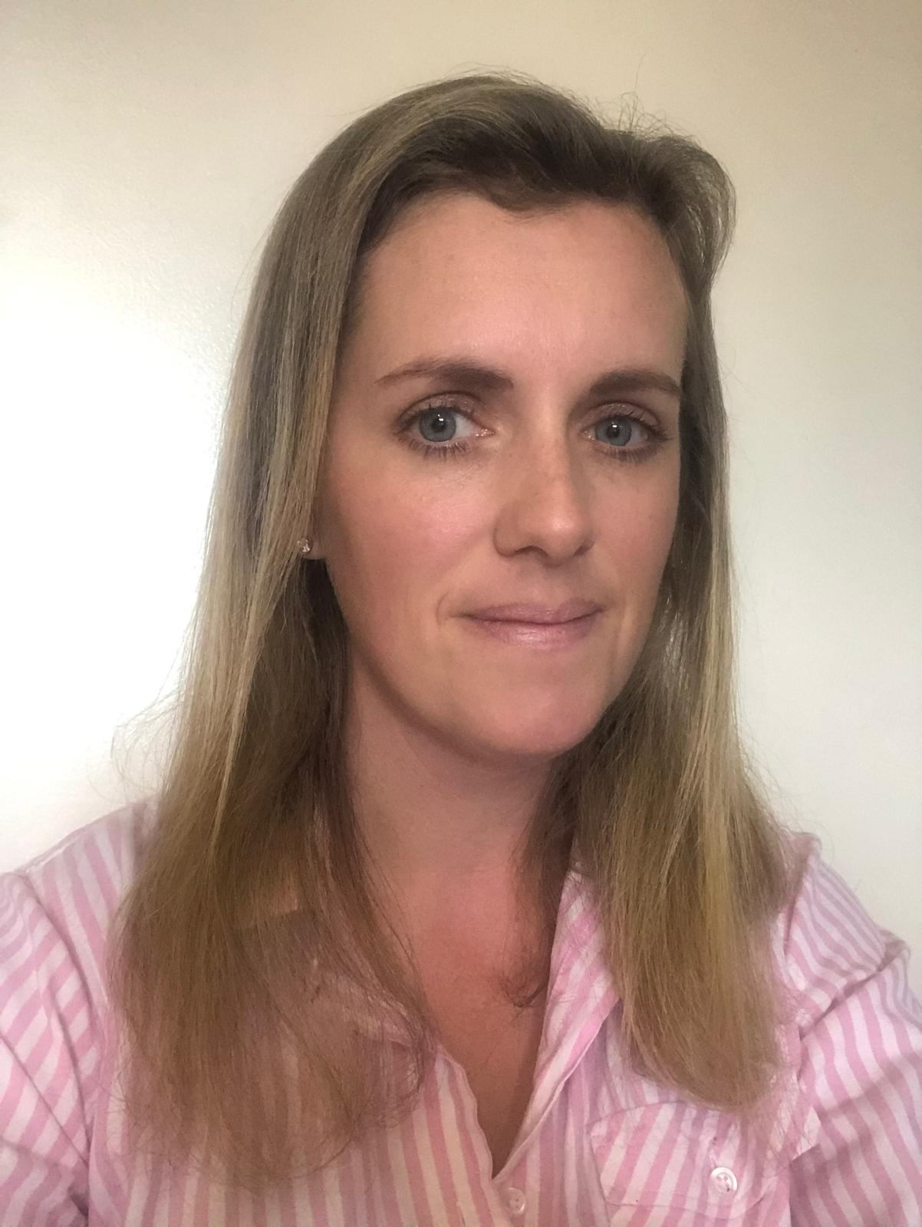
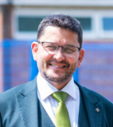

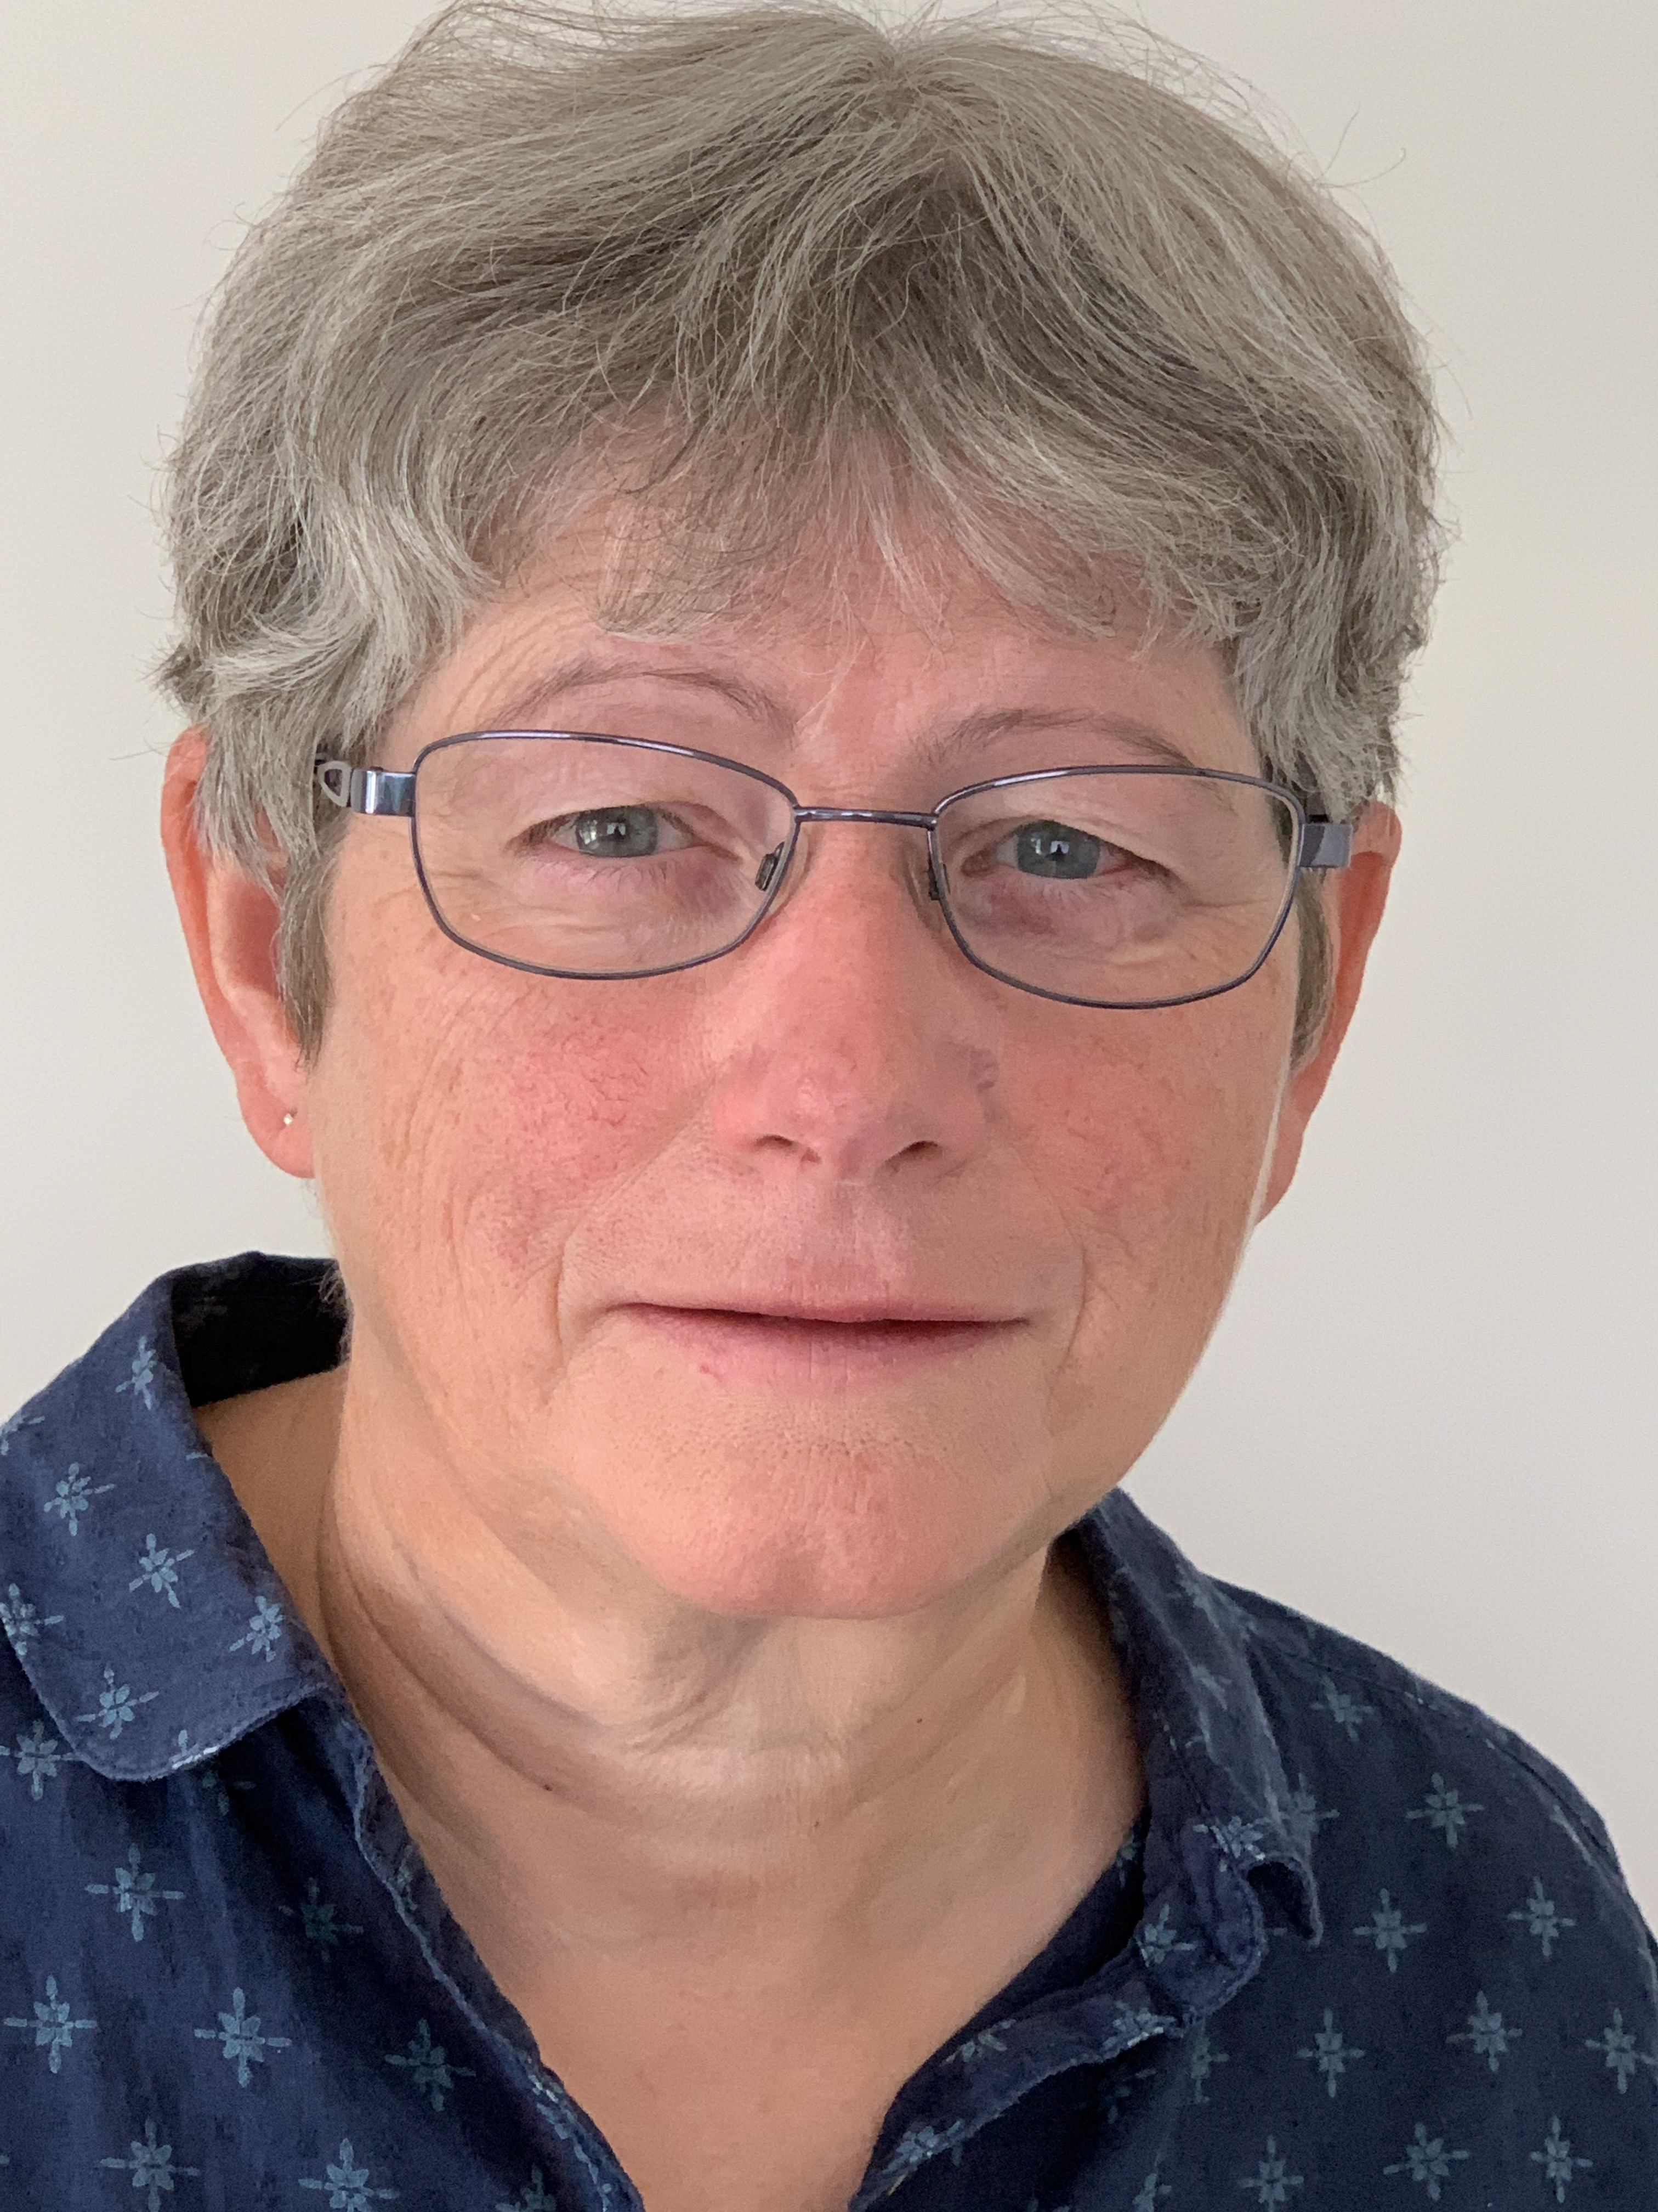

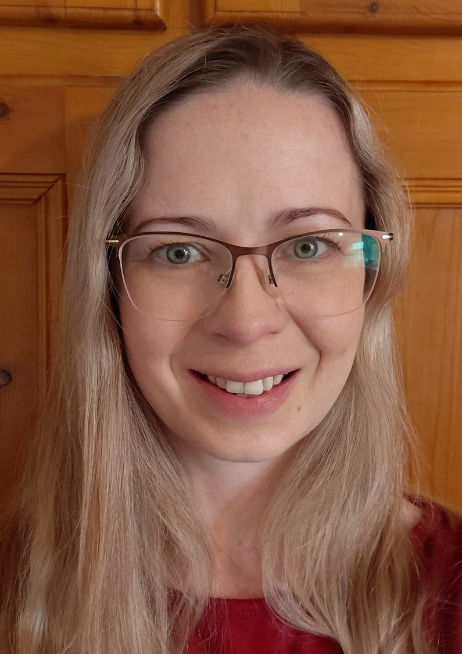

Who’s Who in Our Team?
Mrs L. Cousins
Chair of Governors
Mr C. Jansen
Executive Headteacher
Mrs E. Hunt
Executive Headteacher
Mrs R. Kett
SEND Governor
Mrs K. Farthing
SENCo
Miss G. Hird
SEND Admin
Mrs P. Marlow
Safeguarding and Pastoral

Slide 6
Staff Training
AET whole school Autistic Friendly
Autism (Meadowgate Special School)
Quality First Teaching - Norfolk Virtual School
SEND Consultations - NCC
Speech and Language
Read Write Inc
Step On - Norfolk Steps
CPD programme by West Norfolk Academies Trust & SENDCo (termly)
Adaptations to access our Knowledge Rich Curriculum
Target setting
Talk 4 Writing training

Slide 7
Responsibilities: Primary SENDCo
Work with the Executive Headteachers, SEND Governor to determine the strategic development of the SEND policy and provision in the school.
Have day-to-day responsibility for the operation of this SEND policy and the co-ordination of specific provision made to support individual pupils with SEND, including those who have Educational Health and Care plans.
Provide professional guidance to colleagues and work with staff, parents, and other agencies to ensure that pupils with SEND receive appropriate support and high quality teaching.
Advise on the graduated approach to providing SEND support.
Be the point of contact for external agencies, especially the local authority and its support services.
Liaise with Nursery providers and any potential next providers of education to ensure pupils and their parents are informed about options and a smooth transition is planned.
Work with the Executive Headteachers and governing board to ensure that the school meets its responsibilities under the Equality Act 2010 with regard to reasonable adjustments and access arrangements.
Ensure the school keeps the records of all pupils with SEND up to date.
Liaise regularly with the Assistant SENDCos and SEND Support across the Primary Schools.
Co-ordination of all support for students with special educational needs and/or disabilities.
Ensuring that all staff are aware of each student’s individual needs and/or conditions and the specific adjustments required to enable them to be included and make progress. Providing support and advice so all SEND children reach their potential.
Organising training for staff to ensure that they are aware of and confident in meeting the needs of all SEND students.

Slide 8
Responsibilities: Teaching Staff
In our school the class teacher is recommended as the first point of contact for parental concerns. Each class teacher is a Teacher of SEND and they are responsible for:
The progress and development of every pupil in their class.
Working closely with any teaching assistants or specialist staff to plan, differentiate and assess the impact of support and interventions and how they can be linked to classroom teaching.
Working with the SENCO to review each pupil’s progress and development and decide on any changes to provision.
Ensuring they follow this SEND policy.
As with all children, we have high aspirations and celebrate the educational and personal achievements of SEND children.
Ensure entry to examinations for SEND children.
Be familiar with the SEND Code of Practice and respond appropriately to requests for information, to support the completion of referrals and other documentation needed, as part of review meetings.
Liaise with the SENCo or Assistant SENCo where a child is experiencing difficulty.
Provide a record of a child’s progress towards their individual targets on an IEP (Individual Education Plan) or a Pupil Passport. Children with an EHCP have a different IEP which links directly to the outcomes in their EHCP which may also have additional specific targets. These are reviewed termly with the child and parent /carer, for IEP and the class teacher.
Through Quality First Teaching, Plan appropriately challenging/scaffolded up activities that stimulate a life long love of learning and develops knowledge, understanding, resilience and ambition. This approach also enables all SEND children to have access to the same curriculum content and learning objectives as their peers.
Provide resources that are additional and different from those provided as part of the school’s usual differentiated curriculum. Live mark so that children have immediate feedback and encouragement towards improving their work.
Teachers and Teaching Assistant’s use Bloom’s Taxonomy to help develop positive critical thought processes through questioning and metacognition.

Slide 9
Responsibilities: Student & Home
Students with SEND often have a unique knowledge of their own needs and circumstances, as well as their own view concerning the support they need to help gain the most from their education.
They will be encouraged to participate in the decision making process, including the setting of learning targets and contributing to plans. This will be achieved through a variety of approaches as appropriate to the age of the student. These include:
Student interviews
Questionnaires
Self-evaluation (pictures or written answers)
Student set targets
Home will be expected to provide:
Love
Nourishment
Emotional support
Clothes and equipment
Varied experiences
Wide range of opportunities
Homework support

Slide 10
Definition of Special Educational Needs
& Disabilities (SEND)
Students have a learning difficulty if they:
Have a significantly greater difficulty in learning than the majority of students of the same age.
Have a disability which prevents or hinders them from making use of educational facilities of a kind generally provided for students of the same age in schools within the area of the local education authority.
Are under compulsory school age and fall within the definitions given above or would do so if special educational provision was not made for them.

Slide 11
Types of Special Educational Needs & Disabilities (SEND)
Communication and Interaction
ASD (Autistic Spectrum Disorder, which can include other disorders eg Aspergers)
SLCN (Speech, Language and Communication Needs)
Speech and Language Difficulties
Cognition and Learning
MLD (Moderate learning difficulties)
SLD (Severe learning difficulties)
PMLD (Profound and Multiple learning difficulties)
SpLD (Specific learning difficulties) For example dyslexia, Developmental Coordination Difficulties - dyspraxia, dyscalculia and dysgraphia.
Social Emotional Mental Health
ADHD or ADD (Attention Deficit Hyperactivity Disorder or Attention Deficit Disorder)
ODD (Oppositional Defiant Disorder)
PDA (Pathological Demand Avoidance)
Trauma
ACES
Sensory needs
VI (Visual Impairment)
HI (Hearing Impairment)
MSI (Multi-Sensory Impairment)
Sensory processing difficulties
Physical Difficulties / Disability
Cerebral Palsy Hydrocephaly/ Spastic Quadriplegia
Muscular dystrophy
Developmental Coordination difficulties (Dyspraxia)

Slide 12
Working Together
At Windmill Primary Federation we are committed to working together with all members of our school community. This local offer has been produced in conjunction with students, parents/carers, governors and members of staff.
Parents who wish to provide feedback or become involved in future reviews of our offer are welcome to contact the school on: 01945 880329
Alternatively, please email:
Mrs Kelly Farthing and/or Ms Geena Hird on:
send@windmillfederation.org.uk

Slide 13
Identification of SEND
At Windmill Primary Federation, we are committed to ensuring that all learners have access to learning through Quality First Teaching, scaffolded activities and any additional resources needed to access the same knowledge rich curriculum content and learning objectives as their peers. This not only enables development of their knowledge and understanding, but also develops and extends their skills and abilities. We use imagery, symbols, rehearsal and repetition to help remove barriers to accessing learning and reduce any fear of the written word and/or of failing. It does not follow that all vulnerable learners have SEND. Only those with a learning difficulty which requires special educational provision will be identified as having SEND.
Learners can fall behind for many different reasons. They may have been absent from school or have attended many different schools and not had the opportunity to learn consistently. Slower progress and low attainment will not automatically mean a pupil is recorded as having SEND. Quality First Teaching and identifying in-class support and resources, assessments both in school and externally, monitoring and assessing progress will be the first steps to meeting a child’s needs. Discussions and reviews with class teachers and parents are also central to this process.
We endeavour to ensure that a child’s needs are identified and met as early as possible and adopt the following procedures for identification and assessment. Class teachers will make regular assessments of progress for all pupils and identify those whose progress:
is significantly slower than that of their peers starting from the same baseline
fails to match or better the child’s previous rate of progress
fails to close the attainment gap between the child and their peers
widens the attainment gap

Slide 14
Identification of SEND
We follow the approach outlined in the SEND Code of Practice (2014) which recommends a four-stage cycle of action, known as ‘Assess – Plan – Do – Review’, in which the curriculum and the learning environment will be further adapted by the class teacher to reduce barriers to learning and enable the child to learn more easily. These adaptations may include strategies suggested by the SENDCo and/or external specialists and, if appropriate, provision of specialised equipment or resources. This cycle of support can be in place for a short period of time or a prolonged period and it is reviewed termly. Children who have an EHCP (Educational, Health and Care Plan), or an identified SEND need will automatically have an SSP (School Support Plan).
In some cases a more in-depth, individual assessment may be carried out by the school. This can take many forms, including a reading assessment, observation of the student, one-to-one work in a certain area or a specific support programme/intervention.

Slide 15

Assess - Plan - Do - Review Cycle
If there is an identified special educational need for a student, they may use additional or different interventions to those provided within the usual differentiated curriculum offer and strategies implemented by the class teacher. We will use an “assess-plan-do-review” cycle.
Assess
Plan
Carry out child observations, hold discussions with key staff and parents/carers to identify and analyse the child’s needs. Note the child’s strengths and areas for development.
Assessments from outside agencies (Health, Educational, Psychology, Social Services, etc) may be required with parental consent.
Hold discussions and meetings with parents, colleagues or any specialists who are involved to plan for what support will be put in place.
Make the plan “outcome focused” - what do we all want the child to improve, develop or achieve? The plan should involve the child and parents at the centre.
Identify the interventions and support required and the expected impact on progress, development and behaviour. Set a clear date for review.
Review
Discuss with others involved about how effective the support has been and the impact on the child in line with the review date.
Check back against observations and planned outcomes.
The next steps should be carefully planned with parents, outside agencies and the child themselves. Think about any other colleagues or specialists that might be able to help before the cycle begins again.
Do
Implement the support as planned with class teachers, support staff and any other staff members working together with support from the SENDCo.
Continue with observations to see how the child responds to the support.

Slide 16
Application for an Educational, Health
& Care Plan (EHCP)
If a child continues to make less than expected progress, assistance from external services would be requested, again in consultation with parents. Reports from professionals will be discussed with school staff and parents. Their recommendations may form part of an SEN Support Plan (SSP).
External specialists can play an important part in the very early identification of special educational needs and in advising schools on effective provision.
If a child is still struggling to access learning or making less than expected progress, despite advice, the support and adjustments available and over a prolonged period of time, an application for an Education Health and Care Plan may be considered. We have to make sure we have exhausted all other possibilities for support and the provision expected at SEND Support by the Local Authority. (PeASS)
We also have to complete 2 cycles of the Access Plan Do a Review Process, which is 2 terms.
Where a request for an Education Health and Care Plan assessment is made by school to the Local Authority, the child will have given significant cause for concern. The child’s needs are not being met by the local offer.
Parents can also make applications for EHCP’s and the Norfolk Schools website has the relevant advice and paperwork or please ask us.
If a plan is not agreed there is an appeal process for parents which can include mediation meetings with the Local Authority. They may still decide to uphold their original decision but all views and voices are heard at the meeting which is held by an independent mediator.
An EHCP will not automatically allocate 1:1 support but it will, if successful, detail a child’s strengths, their life journey, their difficulties and the provision the local authority expects to be provided to meet the child’s needs.

Slide 17
The Local Authority & their Support Services in meeting the needs of pupils with SEND
Local offer: https://www.norfolk.gov.uk/children-and-families/send-local-offer
Norfolk County Council’s (NCC’s) local offer for children with Special Educational Needs and disabilities (SEND), has been developed in conjunction with the cluster local core offer in order to provide a consistent response to all students and families in our care.
This local offer will provide clear, comprehensive and accessible information concerning the provision made for students with SEND. It also forms part of the Norfolk Local Offer for learners with SEND.
The SEND and inclusion support line​
Call the SEND and inclusion support line on ​0333 313 7165 ​
Their advisors can help with :
Learn how to access support for children and young people​
Learn about the support available to your child ​
Guidance for families and professionals looking for support and advice​
Guidance and support for children at risk of imminent permanent exclusion​
Guidance and advice for those considering an application for an EHCP ​
This phone line is open Monday to Friday 9am - 5pm, excluding bank holidays.

Slide 18
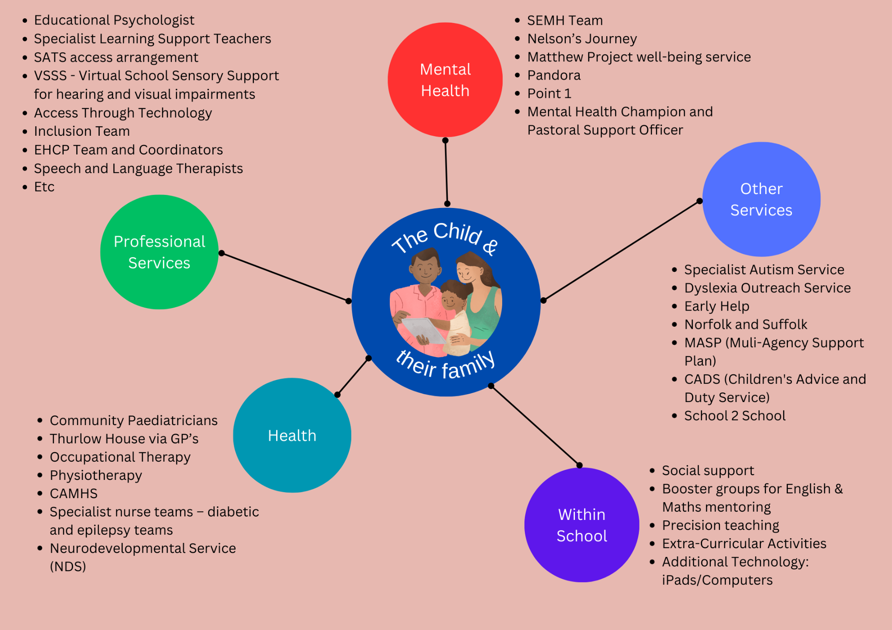
What is the provision for a Child with SEND needs at our primary schools?

Slide 19
Adaptations to the Curriculum & Learning Environment for Pupils with SEND
All Teachers are Teachers of SEND children.
All staff are trained to deliver lessons to a range of specific learning difficulties including dyslexia, autistic spectrum disorder, speech, language and communication needs and behavioural, emotional and social difficulties. Through quality first teaching and making adjustments through scaffolding up of activity resources to increase access to the same curriculum content and learning objectives as their peers.
Additional resources may also be necessary: writing slopes, pencil grips, coloured overlays & tinted-paged exercise books, weighted blankets, shoulder wraps & lap pads, their own working area or a calming area, wobble cushions and ear defenders, etc.
A variety of teaching methods are employed, covering visual, aural and kinaesthetic.
The SENDCo is always available to discuss Teacher’s concerns and to advise on adjustments and/or further assessments by them or an outside agency.

Slide 20
Our School’s Approach to Teaching SEND
Our high quality teaching includes (depending on need):
Our lessons are structured to support SEND students with routine. We will support students with scaffolding. We can support students with transitions with visual timetables if needed
Other practical ways we support our students (this is not a complete list):
  Overlays, coloured paper and exercise books.
  Larger text and lined or squared books.
  Writing slopes, specific pens and pencil grips.
  Read Write Inc for phonic and reading daily.
  iPads/laptops from school or referrals to Access Through Technology (ATT).
  Regular Handwriting practice.
  Own working spaces and calming areas in class where necessary.
  Sensory weighted items to help self regulation as well as exercises.
  Exam access arrangements – quiet spaces, scribes, 25% extra time

Slide 21
Engagement & Learning Support
When necessary, we run planned interventions by need:
Spelling
Reading
Emotional Support
Handwriting
Lego therapy
Socially Speaking
We will work with outside agencies, for example:
Physiotherapy
SALT - Speech and Language Therapists
ATT – Access Through Technology
Other ways we support students:
Physical adaptions and equipment such as hand rails, ramps

Slide 22

Arrangements for Assessing & Reviewing the Progress of Pupils with SEND
Assessment
Effective assessment systems are implemented as early as possible in conjunction with other agencies by:
Encouraging parents/carers and the cluster schools to work together to recognise and support students with special educational and disability needs at the earliest stage, drawing on external advice where necessary and using delegated resources flexibly to make appropriate provision.
Ensuring that the cluster schools, in liaison with other agencies, meet statutory obligations to students with special educational and disability needs and their families within the prescribed timescales.
Working with other agencies to implement Family Support Plans (FSP) as part of a co-ordinated and staged approach to early identification and intervention.

Slide 23
Arrangements for Assessing & Reviewing the Progress of Pupils with SEND
Monitoring
Monitoring progress is an integral part of teaching and leadership at Windmill Primary Federation. Parents, carers, students and staff are all involved in reviewing the impact of interventions for learners with SEN. The ‘assess, plan, do, review’ model is followed to ensure that parents/carers and students are involved in each step. The SENDCo collates the impact data for interventions to ensure that they are effective. Whole school progress data for all students is collated and monitored by teachers, senior leaders and governors. Whole school and cluster data is also monitored by the Local Authority and Ofsted. Student progress towards target outcomes is assessed by:
The use of tracking data to check that progress is good across the curriculum.
Monitoring the progress of all students at least every half term by the Senior Leadership Team and SENDCo.
For students with Statements of SEND or Education and Health Care Plans, the SENDCo and where possible the appropriate teachers and teaching assistants, discuss progress with parents at individual review meetings.

Slide 24
Funding
Each school in the Federation receives funding from the Local Authority to support the needs of students with SEND. See the funding table below:
Year | West Walton | Terrington St John | Tilney St Lawrence | Walpole Highway
2023/24 | £119,713 | £73,950 | £42,296 | £45,392
2024/25 | £138,914 | £57,119 | £69,840 | £53,533
2025/26 | £176,077 | £63,117 | £77,607 | £53,780
The link to our budget share tracker is: https://csapps.norfolk.gov.uk/BudgetShare/default.aspx
Our funding goes towards items such as additional resources and equipment (coloured text books, wobble cushions, ear defenders, lap pads, etc.), support from external agencies (Educational Psychologists, SEMH Team, Benjamin Foundation, Specialist Learning Support Teachers, etc.) as well as staff to provide additional, targeted support and interventions, etc.

Slide 25
Additional Funding
A new incentive from the Local Authority has been implemented, so that we are able to identify the highest needs of our SEND children and request additional funding. This is done via ‘Identification of needs descriptors in educational settings (INDES)’.
INDES are a framework of standardised terms, co-produced and facilitated by the Inclusion and SEND team, breaking down the broad areas of SEND into seven specific sections which describe need:
Physical disability (including physical and neurological impairment, medical, independence and sensory)
Deafness
Visual impairment
Speech and language
Social communication and interaction
Social, emotional and mental health
Learning and cognition difficulties (including behaviour for learning)
The INDES must link in detail to the current provision provided to secure some funding. This funding is not extensive and not always successful but does allow us to make further reasonable adjustments.

Slide 26
Additional Support for Learning
Equipment/Resources for additional support:
We use a range of individual or group programmes to assist learners according to their needs.
Any specific or physical requirements will be assessed individually and equipment will be provided, where possible, to meet those needs with the help of the Local Authority SEND services.
All learners should have the same opportunity to access extracurricular activities. The school offers a range of additional clubs and activities and is committed to making reasonable adjustments to ensure participation for all.

Slide 27
Evaluation of the Effectiveness of Provision
There is clearly a challenge to allocate resources and interventions with respect to funding.
Regular Pupil Progress meetings with class Teachers and SLT highlight where children are making good progress and where they may also need additional support, actions are agreed and followed up.
In providing additional support for students, this will be provided from a perspective of evidence based scenario.
If we have found from school-based or research that interventions do not improve student outcomes we may withdraw this intervention. We will use the ‘assess-plan-review-do’ cycle.

Slide 28
How we enable pupils with SEND to engage in school activities together with pupils without SEND
We have a number of extra-curricular activities that take place at Windmill Primary Federation, ranging from after school clubs to residential trips.
We support students on these by ensuring we make reasonable adjustments so that every young person is included in every aspect of school life.
We therefore undertake risk assessments for all our pupils in conjunction with the school trip leader, parents, and any outside agency where appropriate.
Most of our buildings are wheelchair accessible and we have a number of disabled facilities within school. Ranging from toilet facilities to parking bays.

Slide 29
Support for the Social, Emotional & Mental Health Development of Pupils with SEND
We at Windmill Primary Federation have a ‘whole school approach’ to a young person's well-being. Their well-being and mental health is everyone’s responsibility. That is, all staff, governors, the community and outside agencies.
We have developed a culture of talking about emotions and feelings. There is an acknowledgement of difficulties and it is okay to accept help. We achieve this through assemblies, PSHE lessons, pastoral support, time to talk with any adult a child feels comfortable with and activities in class that cover anti- bullying, cyber bullying, online safety and positive healthy relationships. We use restorative cycles to heal conflicts, giving all concerned a chance for their voice to be heard and to positively move forward.
We use Zones of Regulation across our schools to support all our children.
We can also make referral and work very closely with the Social Emotional and Mental Health Team (SEMH) - an outside agency who work with children intensively over a six week period for a diverse range of needs.

Slide 30
Consultation with Parents & Young People about SEND and Involving in their Education
In accordance with the SEND Code of Practice, Windmill Primary Federation believe that all parents of children with SEND should be treated as equal partners. The cluster schools have positive attitudes to parents, provide user-friendly information and strive to ensure that they understand the procedures and are aware of how to access advice and support.
Parents will be supported and enabled to:
Recognise and fulfil their responsibilities as parents and play an active and valued role in their children’s education.
Have knowledge of their children’s entitlements within the SEND framework.
Make their views known regarding how their children are educated and, where appropriate, co-produce plans to meet their Special Educational Needs.
Access information, advice and support during the assessment process.

Slide 31
Transition Support Between Previous or Future Setting and Windmill Primary Federation
Windmill Primary Federation is committed to working in partnership with children, families and other providers to ensure positive transitions. Transition may be to a new class in school, a new teacher or moving to a new school.
Prior to admission to Windmill Primary Federation, we liaise closely with other professionals who have had recent links with the pupil in the following ways:
Additional visits and discussions with parents and the child
For those with an EHCP, and where this is known in sufficient time, interventions will be planned and in place for the first weeks.
Where a nursery provision has identified a child as having a SEND and additional support this will be recorded, shared with teaching staff and monitored.
Where progress is not as expected the class teachers, in conversation with the SENDCo, will discuss further assessment and other support that could be put in place.
We also work closely with other professionals at the high schools our SEND pupils are transitioning to. This ensures the pupil has an opportunity to familiarise themselves with the new setting and/or meet core staff who will be working with them. In doing this, this also allows the high school the opportunity to prepare or tailor any spaces and/or equipment that might be required to support individual students.

Slide 32
Complaints Procedure
Parent views are important. The first point of contact is always the person responsible, which may be the class teacher, or SENDCo. In the first instance we will seek to resolve any complaint at the informal stage (stage 1)
If this does not resolve the matter, parents should refer to the relevant Executive Headteacher who will arrange to investigate your concerns at the formal stage (stage 2)
If parents still feel their concern is not resolved they can make a request for their complaint to be reviewed by the Governing Body (stage 3).
Please refer to Complaints Procedure Policy (on our website).

Slide 33
Signposting of Policies and Procedures
To view our policies, simply visit www.windmillfederation.org.uk About Us Policies
Accessibility Policy
Admission Policy
Behaviour Policy
Equality & Diversity Policy & Objectives
Medical Needs Policy
Safeguarding Policy
SEND Policy

Slide 34
Further Sources of Support
Support Name | Website address | Email address | Telephone | Brief Description of Service | Who is it for?
Local offer | https://www.norfolk.gov.uk/children-and-families/send-local-offer | n/a | n/a | Find information on support in education Learn about special needs services that can help children, young people and their families Find a support network - parents, groups and organisations. Get guidance and advice about how to help a young person plan their adult life | Anyone in the life of a child or young person aged 0-25 who has a special educational need and/or disability (SEND) in Norfolk.
Norfolk SENDIASS (Information, advice & support services) | https://www.norfolksendiass.org.uk | norfolksendiass@norfolk.gov.uk | 01603 704070 | We provide free and impartial information, advice and support about special educational needs & disabilities (SEND). | For children, young people, parents and carers.
Contact a family | https://contact.org.uk/ | info@contact.org.uk | 0808 808 3555 | Contact is a trading name of Contact a Family. We run a free helpline for parents and carers with a disabled child aged from birth to 25, living in any part of the UK. Your child does not need a diagnosis for you to call our helpline. We support families, bring families together and help families take action for others. | Parents and carers with a disabled child.
SEND Gateway | https://www.sendgateway.org.uk/ | info@wholeschoolsend.com | 020 3925 3596 | The SEND gateway is an online portal offering education professionals free, easy access to high quality information, resources and training for meeting the needs of children with special educational needs and disabilities (SEND). | Educational professionals
Independent Parental Special Education Advice (IPSEA) | https://www.ipsea.org.uk/ | office@ipsea.net | 01799 582030 | Our vision is that children and young people with special educational needs and disabilities are able to fulfil their potential. We help children and young people with special educational needs and disabilities, and their families and carers, to get the appropriate education, training and support to which they are entitled under the law. | Children and young people with special educational needs and disabilities, and their families and carers
Family Voice | https://www.familyvoice.org.uk/ | office@familyvoice.org.uk | 07950 302937 | Is the parent carer forum for Norfolk. We work with (not for) the local authority, health and social services to improve services for children and young people with special educational needs and/or disabilities (SEND) and their families. | Families, children and young people with SEND.

